Slide 1
HOSPITAL MANAGEMENT SYSTEM
PRESENTED BY:
ABHAY THAKUR CL2025010601877582
SUSHANT GUPTA CL2025010601877380

Slide 2
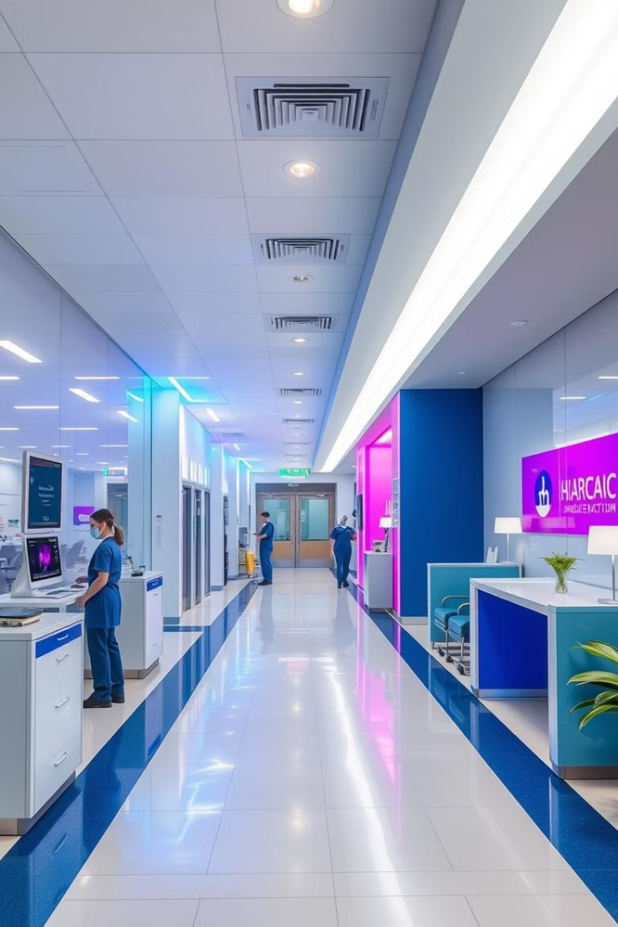
Introduction
The Hospital Management System is designed to efficiently manage patient records, staff details, and appointments using Java and MySQL.

Slide 3

Key Features of a Modern HMS
Add New Patient
Update Patient Details
Patient Information
Employee Information
Room & Department Management
Hospital Ambulance Services
Patient Discharge
Search Room
Logout Functionality

Slide 4
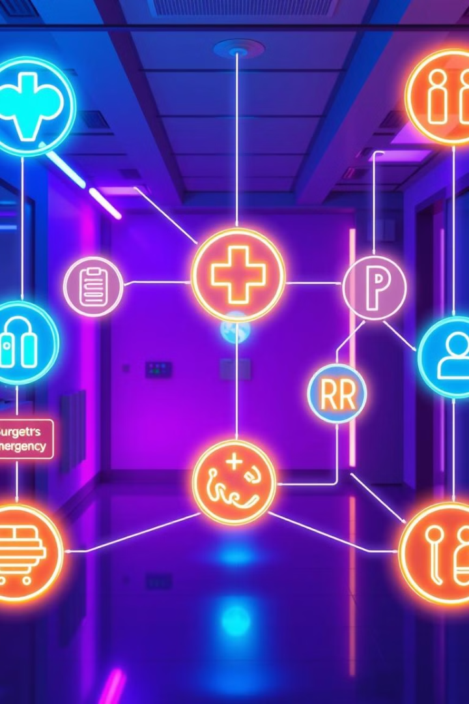





System Workflow
A patient is registered in the system.
Their information is stored and updated as needed.
Room and department are assigned accordingly.
Employees can manage hospital records efficiently.
Patient discharge and ambulance services are handled within the system.

Slide 5

Advantages
Improves hospital workflow efficiency
Reduces paperwork and errors
Provides secure access to patient data
Enhances record-keeping and retrieval speed

Slide 6

Security: Protecting Sensitive Patient Data
1
Data Encryption
Protecting data at rest and in transit.
2
Access Control
Role-based access for authorized users.
3
Regular Audits
Security audits to identify vulnerabilities.

Slide 7




Future Enhancements:
AI Diagnostics
1
Telemedicine
Faster, more accurate diagnoses.
2
Remote patient monitoring.
Predictive Analytics
4
Blockchain Security
3
Optimizing treatment plans.
Enhanced data protection.

Slide 8
Demo

Slide 9

Conclusion: The Future of Healthcare is Digital
Hospital Management System (HMS) helps improve healthcare by making patient care better and hospital work more efficient. It is important to keep improving and adapting to new technology. A strong and secure HMS is essential for the future. Our Java-based HMS provides key benefits to enhance healthcare. Using technology can improve patient care and simplify hospital operations.

Slide 10
THANK YOU

